Slide 1

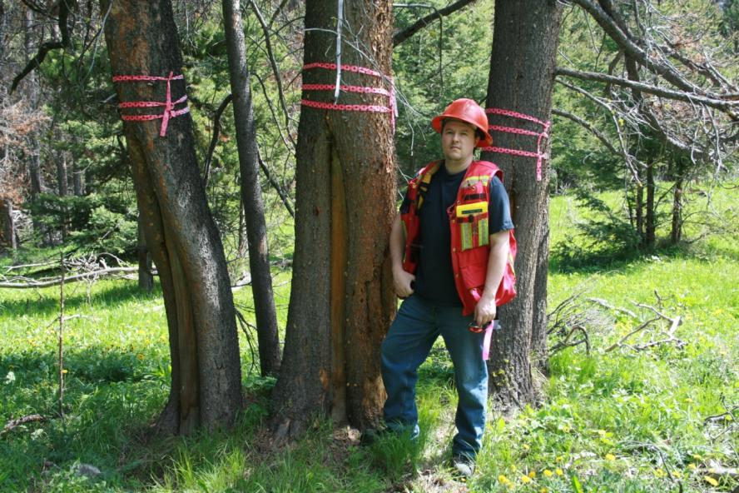
Cultural Heritage Resources (CHR)
Resource Stewardship Monitoring

Slide 2
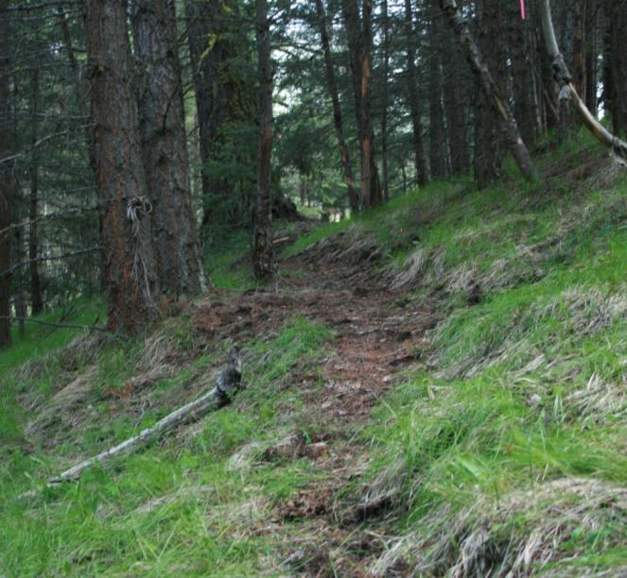
Training Outline
Context (30 minutes)
CHR/Archaeological sites and features (180 minutes)
Filling out the Field Cards (90 minutes)
Field Practice (1 day)
Notes:
These materials were put together by (or with the help of) the following people:
Frank Craig, Archer
Kathleen Hebb, FLNRO - Vanderhoof
Steve Lehnert, FLNRO - Kamloops
Lisa Levesque, Min of Agric. (formerly FLNRO – Resource Practices Branch)
Diane Goode, FLRNO – Aboriginal Affairs
Doug Glaum, FLNRO – Archaeology Branch
Mike Larock, ABCFP (professional reliance)
Peter Bradford, FLNRO – Resource Practices Branch

Slide 3
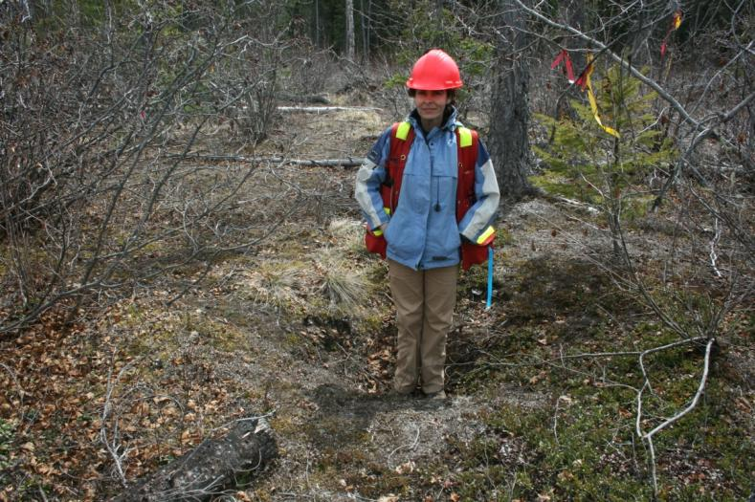
Cultural Heritage Resources
A cultural heritage resource (CHR) is an object, a site or location of a traditional societal practice that is of historical, cultural, or archaeological significance to British Columbia, a community or an aboriginal people.
(Forest Act)

Slide 4
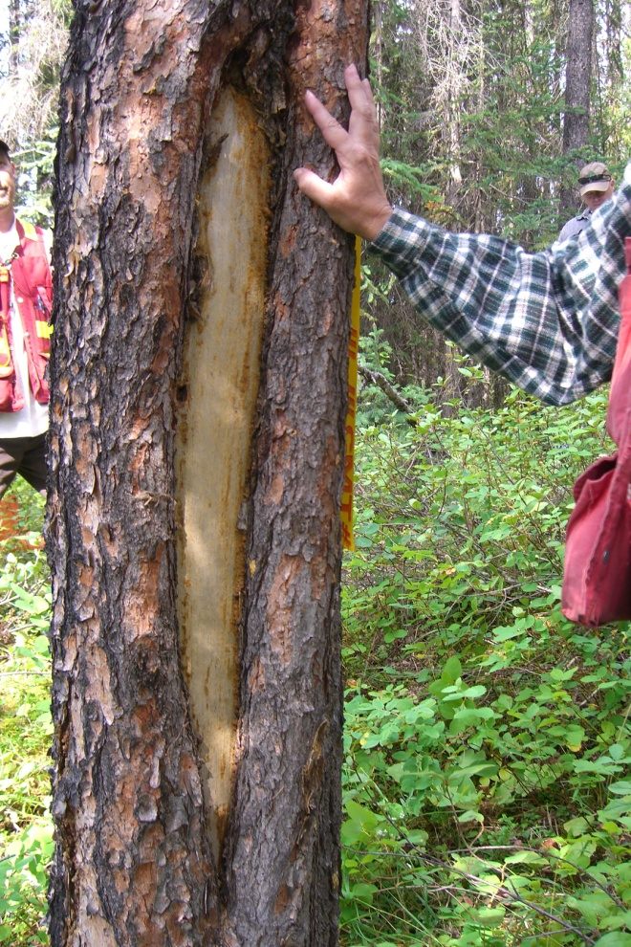
Cultural Heritage Resources
Archaeological Sites
Heritage Sites
Cultural Features and Sites
Traditional Use Sites
Notes:
CHR’s cover four types of sites and features

Slide 5
Archaeological Sites
Archaeological site – materials or other physical evidence of human habitation or use before 1846
Archaeological sites may contain:
a) artifacts, human remains, and food remains; or
b) alterations to the landscape or features (including pits, mounds, and forest modifications) resulting from past human activities.
Notes:
Archaeological sites may contain:
a) material remains like artifacts, human remains, and food remains; or
b) alterations to the landscape or features (including pits, mounds, and forest modifications) resulting from past human activities.
Obligations and management covered by Heritage Conservation Act (section 13)
Also covered are:
Burial sites, rock art of historical importance (includes post 1846),

Slide 6
Heritage Sites
"heritage site" means, whether designated or not, land, including land covered by water, that has heritage value to British Columbia, a community or an aboriginal people;
Notes:
Both aboriginal and non-aboriginal
Covered by Heritage Conservation Act
Examples:
aircraft and ship wrecks > 2 years old
Historic buildings and artifacts , heritage trails
Protection of Heritage Sites: You cannot damage a Provincial heritage site or a Provincial heritage object or remove from a Provincial heritage site or Provincial heritage object any heritage object or material that constitutes part of the site or object;
(b) damage, desecrate or alter a burial place that has historical or archaeological value or remove human remains or any heritage object from a burial place that has historical or archaeological value;
(c) damage, alter, cover or move an aboriginal rock painting or aboriginal rock carving that has historical or archaeological value; (does not need to be pre 1846)
(d) damage, excavate, dig in or alter, or remove any heritage object from, a site that contains artifacts, features, materials or other physical evidence of human habitation or use before 1846;

Slide 7
CHR Features (non-archaeological)
Cultural heritage resources that are focused on a traditional use and/or continuing importance to First Nations but do not meet the definition of an archaeological site.
Notes:
Examples:
Post 1846 CMTs and trails, bark stripping, food / plant gathering, nests, dens, caves, trappers cabins etc.
Obligations and management covered by the Forest and Range Practices Act

Slide 8
Traditional Use Sites
Any geographically defined site that has been traditionally used by one or more groups of people for certain types of activities.
Include:
  Sacred sites,
  Resource gathering sites, and
  Sites of legendary or past event of cultural significance.
Notes:
Can be on land or water
These are not archaeological sites – They lack the physical evidence required to be an archaeology site
Often lack physical evidence
Often through oral history
Regulated under FRPA

Slide 9
Why Manage Cultural Heritage Resource Values?
Laws and court decisions
Evidence of rights
History of BC
Non-renewable
Notes:
Laws (arch sites) and court decisions (FN rights and government obligations)
They provide important evidence regarding the past/current practice of an aboriginal right.
Archaeological sites contain the material history of aboriginal people, and are of great cultural, historical, and spiritual significance to First Nations peoples.
98% of the span of British Columbia’s human history is represented by archaeological sites.
CHRs are non-renewable resources, and once disturbed or destroyed the knowledge (12,000 years +) we can gain from them is lost forever.
Reference provincial FN consultation procedures

Slide 10
Legislation, Policy, Court Decisions &
Professional Reliance
Constitution Act (1982)
Forest Act
Forest Planning and Practices Regulation (FRPA)
Heritage Conservation Act (HCA)
Court Decisions
  E.g., Haida, West Moberly, Delgamuuk’w, William Case
Professional Reliance
Notes:
Constitution Act – “existing aboriginal and treaty rights of the aboriginal peoples of Canada is recognized and affirmed…”
Forest Act – defines "cultural heritage resource" as an object, a site or the location of a traditional societal practice that is of historical, cultural or archaeological significance to British Columbia, a community or an aboriginal people;
FPPR and HCA – more detail in subsequent slides
There have been a number of court decisions that have provided further clarification regarding the Crown’s duty to consult with First Nations regarding proposed decisions and how these decisions may impact a First Nation’s aboriginal interests (either asserted or proven aboriginal rights and title or treaty rights). A CHR may meet the requirements of and therefore, be considered an aboriginal interest in some situations. For more information regarding the Crown’s consultation obligation and process see the Updated Procedures for Meeting Legal Obligations when Consulting First Nations.
https://gww.arr.gov.bc.ca/arr/news/arr_2010_07_29_new_bc_government_consultations_procedures_are_now_public.html
Professional Reliance: The management of CHRs is also a professional reliance consideration. Under PR, resource professionals are relied on to understand both the legal and the non-statutory realm in order to provide the best advice to their employer (government, tenure holder…) on how to manage their business and make informed operational decisions based on mindful consideration of relevant issues, values and concerns (due diligence). In this case those issues, values and concerns are related to CHR values and FN interests and perspectives.

Slide 11
What Do Court Decisions Tell Us?
First Nations have a recognized connection to the land and aboriginal interests (claimed or proven aboriginal rights and title or treaty rights)
Government has an obligation to consult with FNs regarding proposed decisions that may impact aboriginal interests
As part of the consultation process, the Government, where appropriate may need to accommodate aboriginal interests.
Notes:
The Crown has a legal obligation to consult with FNs regarding a proposed decision that may impact their aboriginal interests. The consultation process involves a number of steps that are clearly defined in the “Updated Procedures for Meeting Legal Obligation when Consulting First Nations”. In general terms, as part of the consultation process, the Crown considers the strength of aboriginal interests, the potential impact a proposed decision may have on those aboriginal interests, the level of consultation, and where appropriate, accommodation measures to address impacts that will occur.
William (Tsihqotin) Case tells us:
Increasing emphasis on the significance and implications of aboriginal rights including the need to preserve, protect and manage resources to ensure continued aboriginal harvesting rights (access / hunt / fish / gather)
Government needs to have reasonable and adequate assessment and evaluation of resources imporatnat to First Nations
Government needs to safe-guard and protect resources important to traditional lifestyles, cultures and traditions – ensure continued use and rights
Wildlife, fish, riparian, plant gathering is critical

Slide 12
Forest Planning and Practices Regulation
The FPPR regulates the management of cultural heritage resources that may be altered by forestry operations
Section 10 refines the definition of a cultural heritage resource under the Forest and Range Practices Act (FRPA). The FPPR states the following objective set by government: "to conserve, or, if necessary, protect cultural heritage resources that are:
a) the focus of a traditional use, by an aboriginal people, and that are of continuing importance to that people; and
b) not regulated under the Heritage Conservation Act."
Notes:
FRPA contains legislative requirements, which must be met by a licensee, that are important and relevant to the consultation process. These requirements include sharing information with the FN regarding the FSP and developing results or strategies to address the cultural heritage resource objective.
Although not legally required, another very important component is relationship building with FNs by both the Crown and licensees. Positive relationships can often lead to more effective and efficient consultation processes.

Slide 13
Heritage Conservation Act
Administers the legal responsibility of government, industry and the public to avoid or manage impacts to archaeological sites
The HCA is designed “to encourage and facilitate the protection and conservation of heritage property in the Province,”
http://www.for.gov.bc.ca/archaeology/index.htm

Slide 14
Sites Automatically Protected by the Heritage Conservation Act (HCA)
Archaeological sites have physical evidence of human occupation or use before 1846
Aboriginal rock art with historical or archaeological value
Burial places with historical or archaeological value
Heritage wrecks
Heritage sites of unknown age with a reasonable possibility of having been occupied or used before 1846.

Slide 15
HCA Offences & Penalties
Section 36 (1) of the HCA states that a person commits an offense if they contravene Sections 13 (6), 14 (1) or 14 (8). Under Section 36 (3) a person convicted of an offense under subsection 1(d) is liable:
a) If the person is an individual, to a fine of not more that $50, 000.00 or to imprisonment for a term of more than two years or both, or
b) If the person is a corporation, to a fine of not more than $1,000, 000.00

Slide 16
Confidentiality
CHRs are potentially sensitive and/or confidential information
Ask First Nations and speak to your district consultation coordinator on how to best manage monitoring data
Notes:
Some sites and/or features may be sensitive, generally unknown, sacred and/or of high spiritual value. It is important to ensure that FREP CHR monitoring data is kept confidential if advised so by local First Nations and/or the district consultation coordinator.

Slide 17
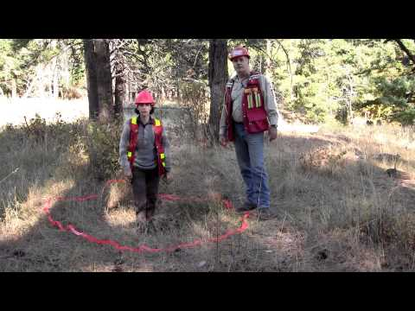
FREP Resource Stewardship Monitoring
FREP Question:
Are cultural heritage resources being conserved for First Nations cultural and traditional activities?
http://www.youtube.com/user/frep101
Notes:
Significant effort has been made in communicating FREP (indicators, data, results, recommendations etc.)
YouTube Videos
Reports
Extension Notes
Presentations (licensees, PAC, Academic, SISCO, ABCFP, etc.)
Posters
Individual licensee presentations (their data)

Slide 18
CHR Features and Archaeological sites
physical traces of the past

Slide 19
Common CHR Types
Culturally Modified Trees
Cultural Material
Cultural Depressions
Cultural Trails
Traditional Use Sites
Historic Sites

Slide 20
Culturally Modified Trees (CMTs)

Slide 21
Culturally Modified Trees (CMTs)
A tree that has been altered by native people as part of their traditional use of the forest.
Non-native people also have altered trees, and can be difficult to tell if a modification is of native or non-native origin.
The term is commonly used to refer to trees modified by native people during traditional tree utilization, and is used as such in this course.
There are many kinds of CMTs in British Columbia.

Slide 22
Why Record CMTs?
Have cultural significance to First Nations groups
Dateable features of traditional forest subsistence
Legal obligations to manage for CMTs during forest planning and operations (HCA)
Can play a role in determining aboriginal rights or title in treaty & land use negotiations
May be linked to archaeological sites, oral histories, and traditional use sites
Data collected from CMTs can confirm trail routes, identify travel patterns, settlement patterns, subsistence, seasonal rounds, and population fluctuations
Analysis of CMT data can correlate traditional use with past environmental and cultural events such as drought, European-contact, or famine.
Notes:
Forestry operations include harvesting, road building, silviculture etc.

Slide 23
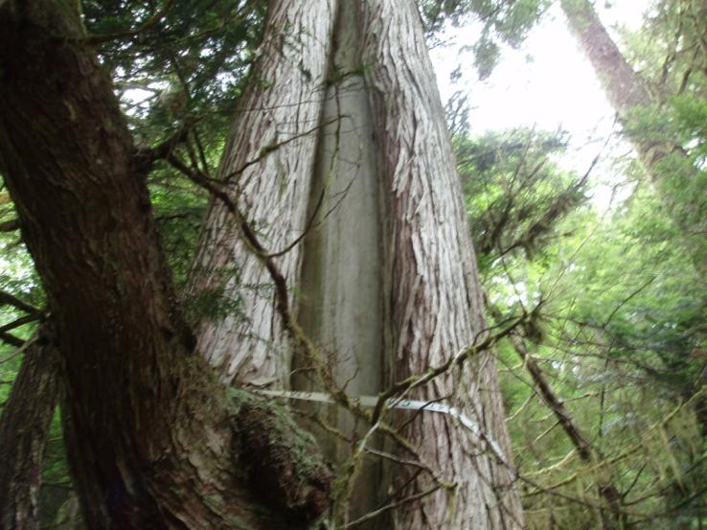
CMTs
Coastal BC
Notes:
Culturally Modified Trees of British Columbia: A Handbook for the Identification and
Recording of Culturally Modified Trees http://www.for.gov.bc.ca/ftp/archaeology/external/!publish/web/professionals/cmthandbook.pdf
Archaeology Branch

Slide 24
CMTs of Coastal BC
bark-stripped trees
stumps and felled logs
trees tested for soundness
trees chopped for pitch
trees with scars from plank removal
arborglyphs (e.g. face trees)
trees delimbed for wood

Slide 25
Coastal CMTs
Species: C (western red cedar), YC (Yellow Cedar), H (hemlock), B (Balsam)
Class: Bark Strip Tree (BS), Aboriginally-Logged Tree (AL), Other Modified Tree
BS Type: T (Tapered), R (Rectangular), G (Girdled)
AL Type: T (Test Hole), U (Undercut), F (Felled), S (Sectioned), ST (Stump), N (Notched), P (Planked), C (Canoe)
Other Type: P (Pitch C.), K (Kindling), D (Delimbed)
Feature / BS: T (Tapered), R (Rectangular), G (Girdled)
Feature / Stump: BC (Barberchair), F (Flat), S (Step), U (Unknown), N (Basin)
Feature / Sectioned: B (Butt), M (Medial), C (Crown), MS (Missing)
Feature / General: PL (Platform Notch), TH (Test Hole), US (Undercut Scar), N (Notched), PS (Plank Scar), PCS (Pitch Collection Scar), KRS (Kindling Removal Scar), LD (Logging Detritus)
Side: U (Upslope), D (Down Slope), S (Side Slope)
Tool marks: yes or no, if yes indicate type
Nursing Tree: yes or no, if yes indicate species

Slide 26
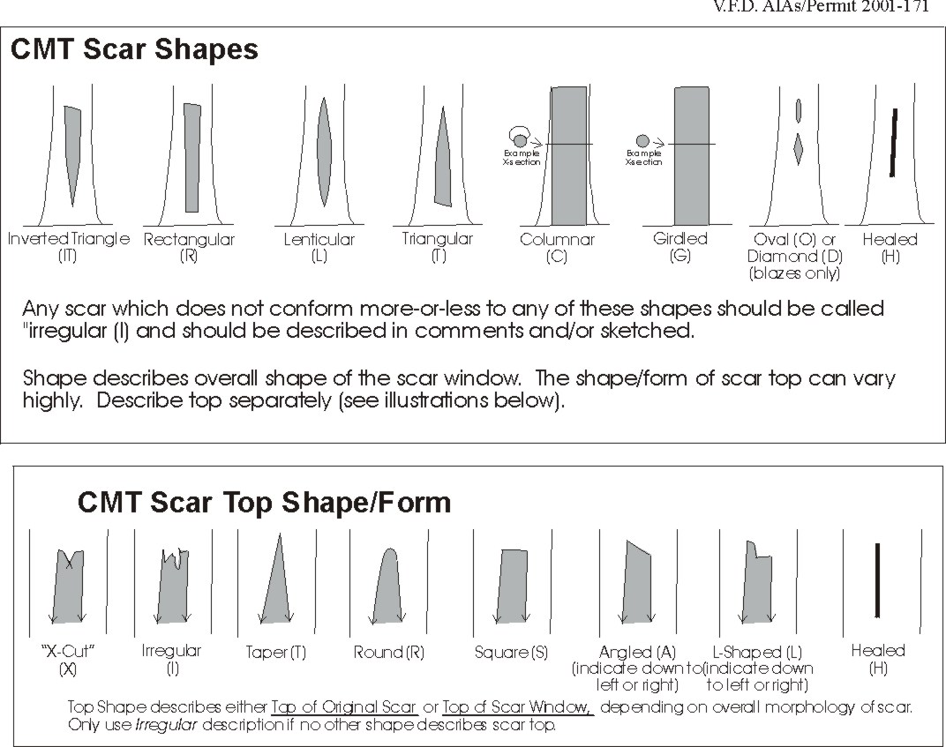
CMT Morphology

Slide 27
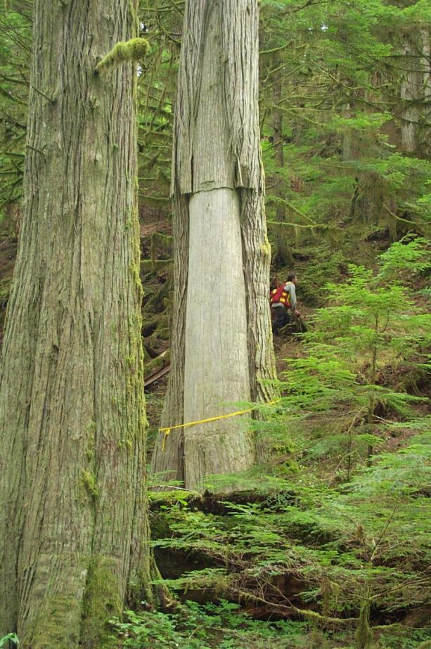
Bark stripped cedar

Slide 28
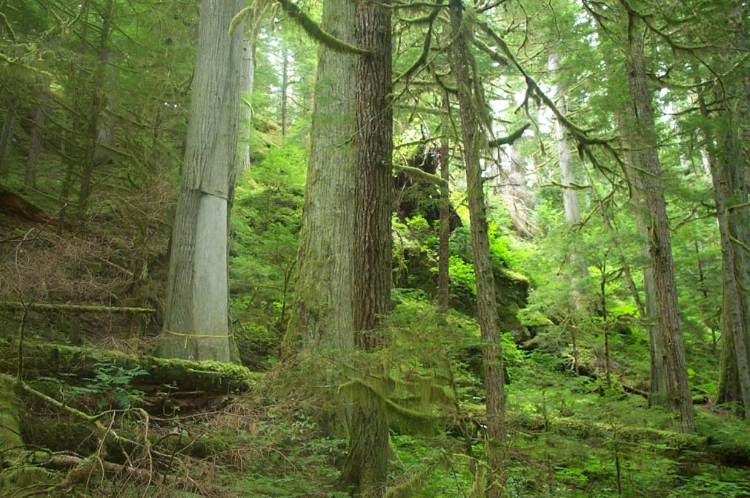
Bark stripped cedar

Slide 29

Tapered bark stripped cedar

Slide 30
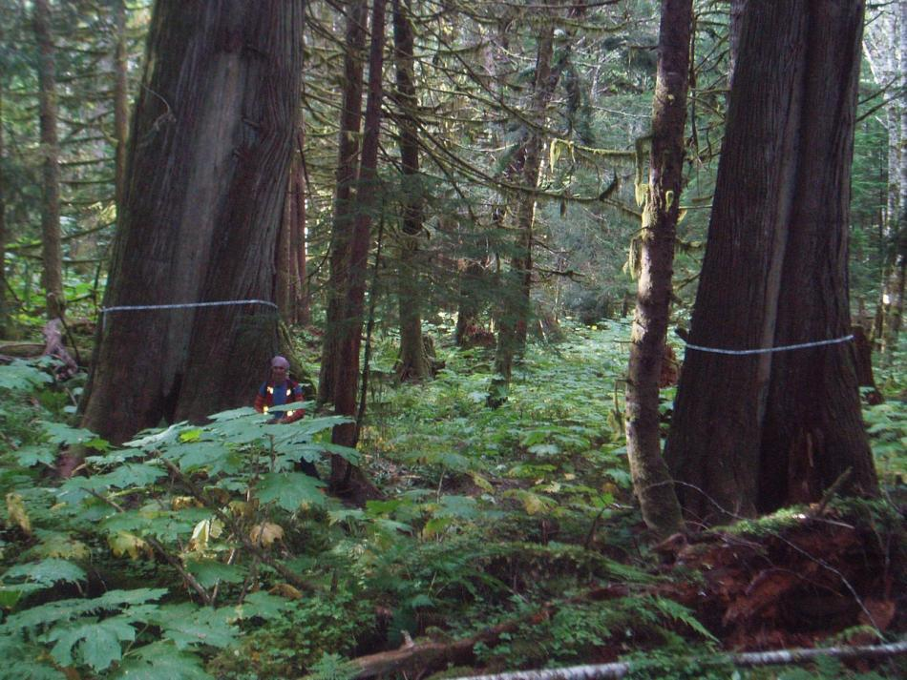
Rectangular vs. tapered scar

Slide 31
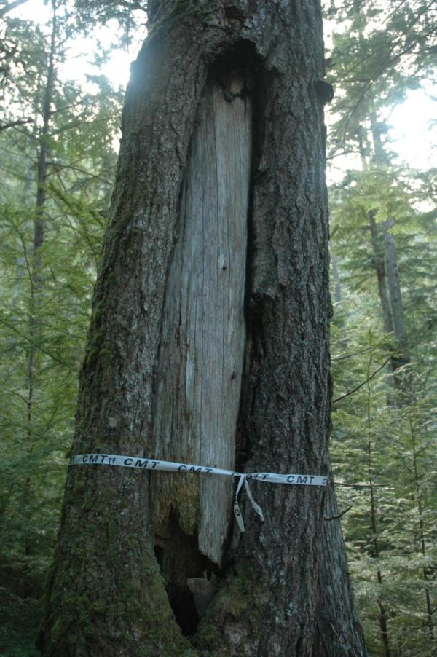
Bark stripped hemlock

Slide 32
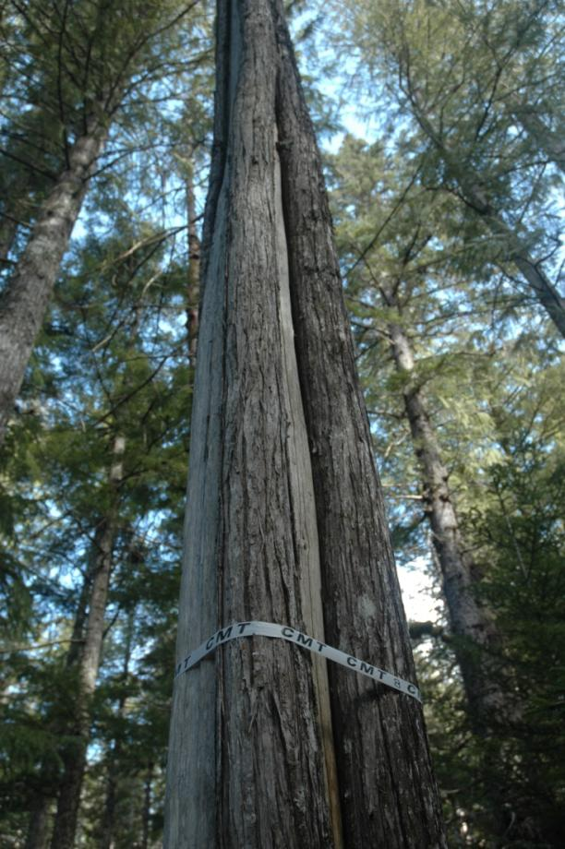
Multiple stripping on cedar

Slide 33
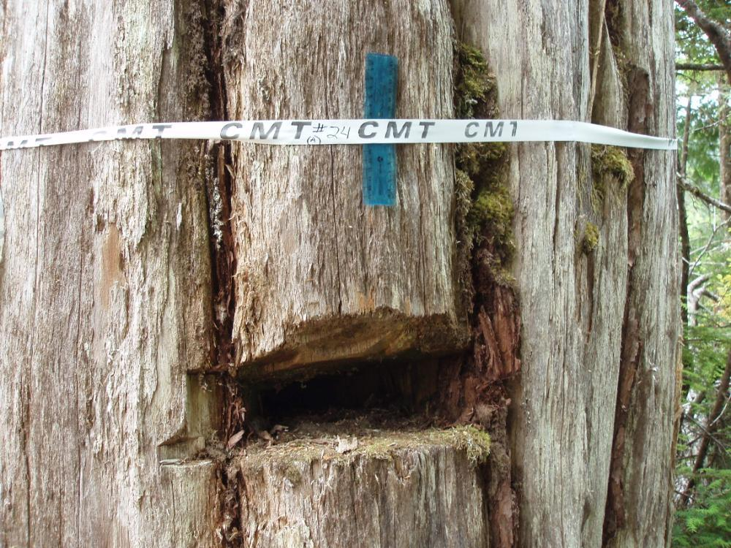
Test hole

Slide 34
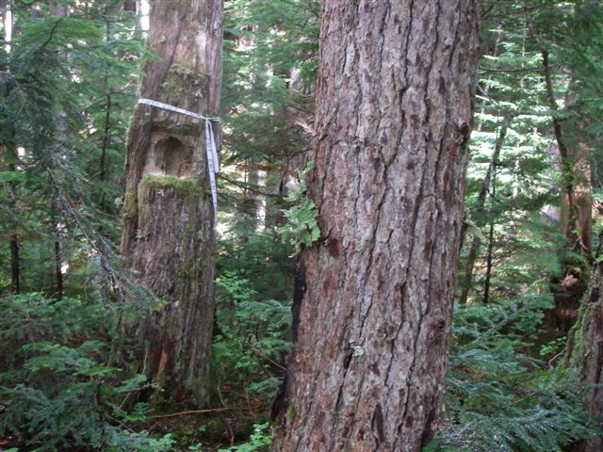
Test trees

Slide 35
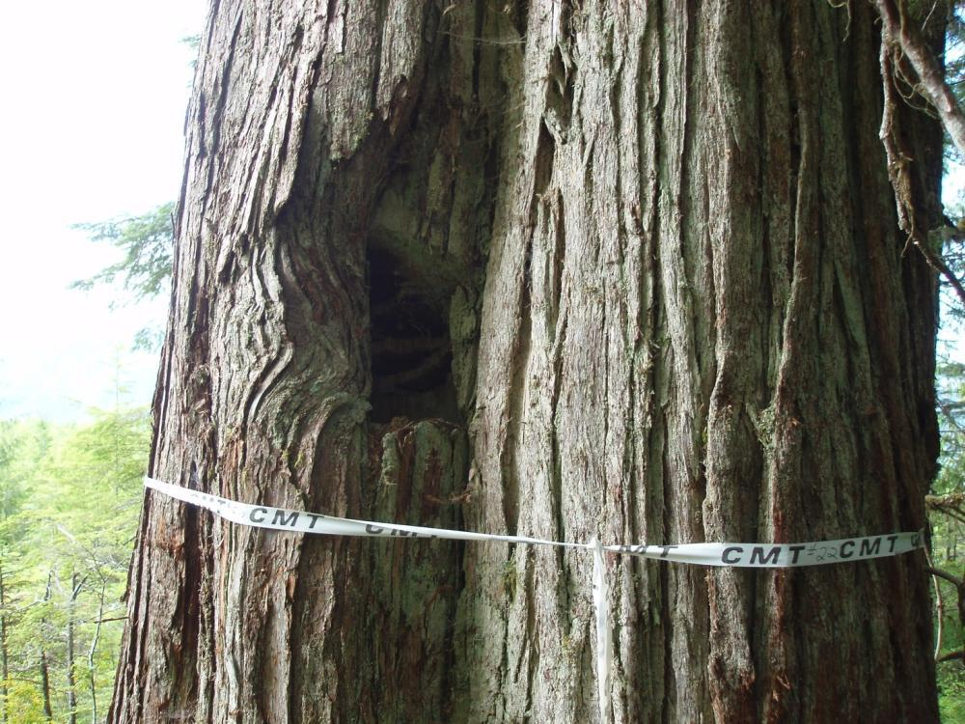
Test hole

Slide 36
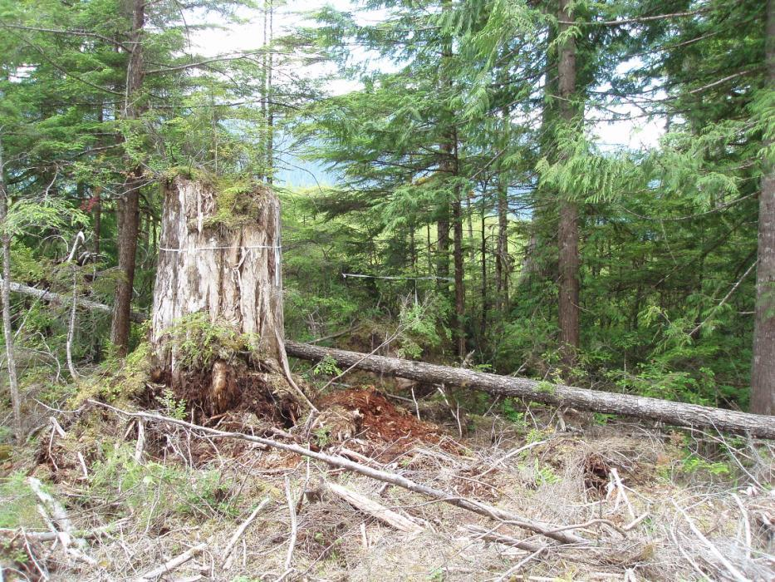
Aboriginally logged

Slide 37
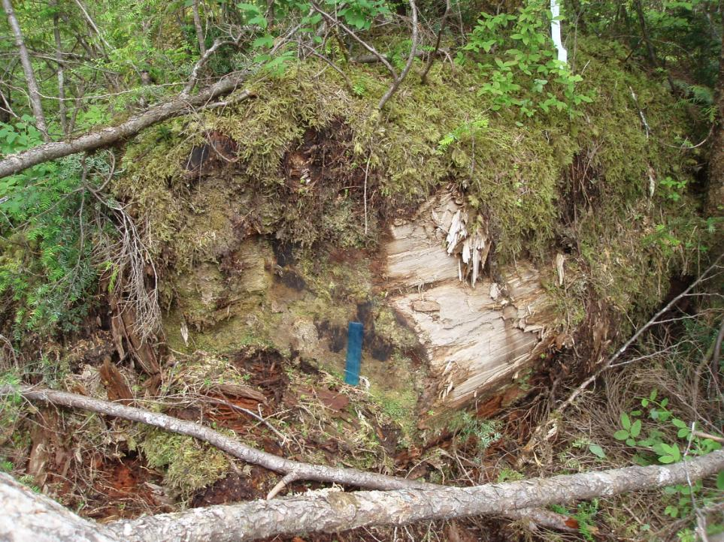
Aboriginally logged

Slide 38
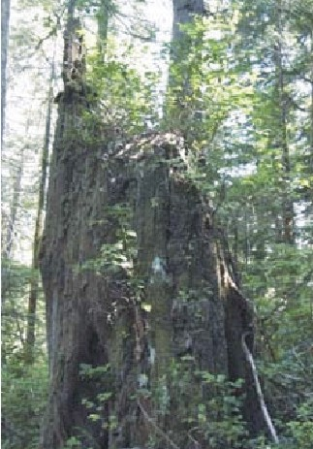
Aboriginally logged
Barber Chair

Slide 39
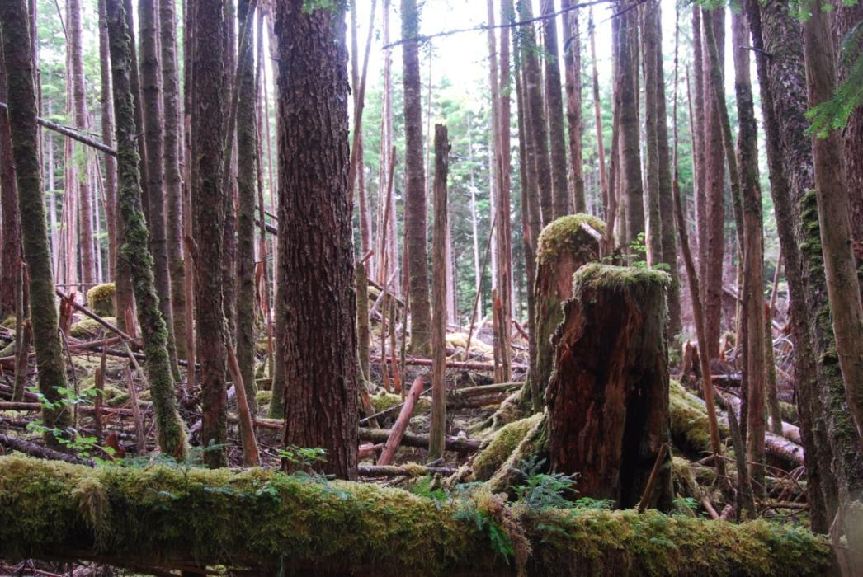
Saw cut stumps from industrial logging, 1860’s.
Note flat surface compared to archaeological axe/adze cut stumps. CMTs were dated by coring nursing trees from stumps, giving minimum age for CMT.

Slide 40
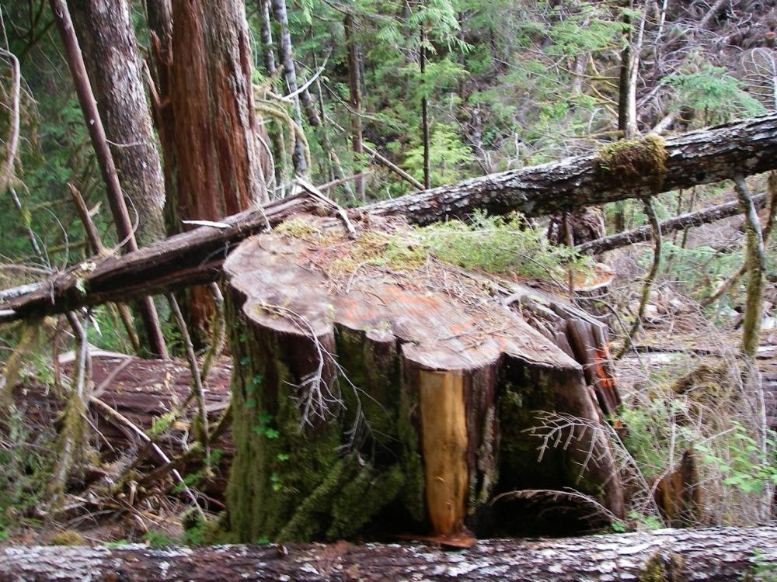
Modern logging

Slide 41
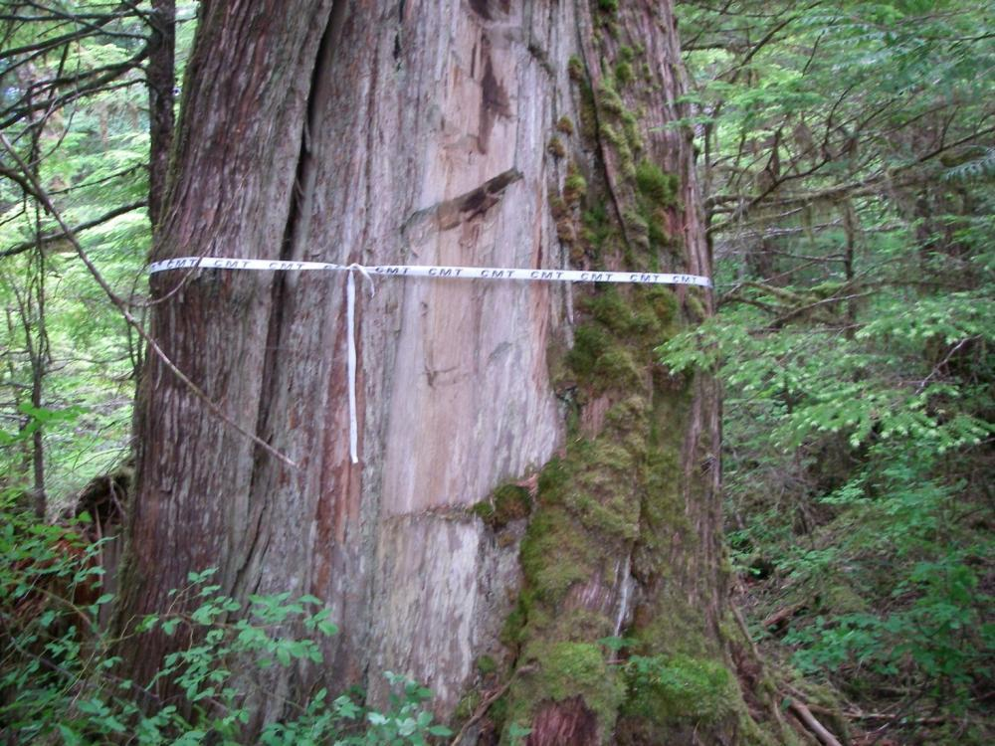
Chopped cedar

Slide 42
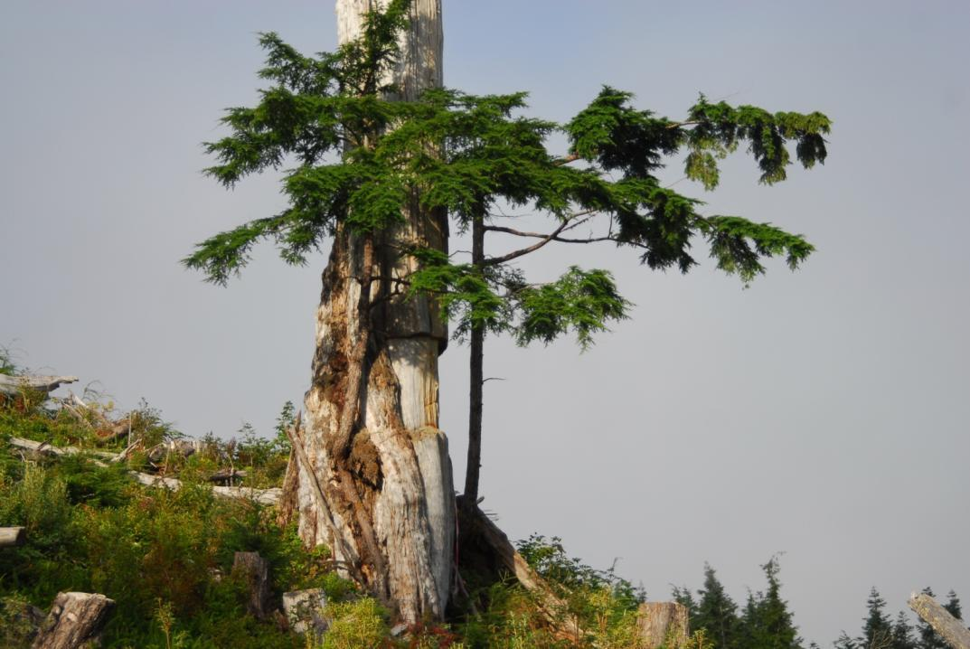
Plank Removal

Slide 43
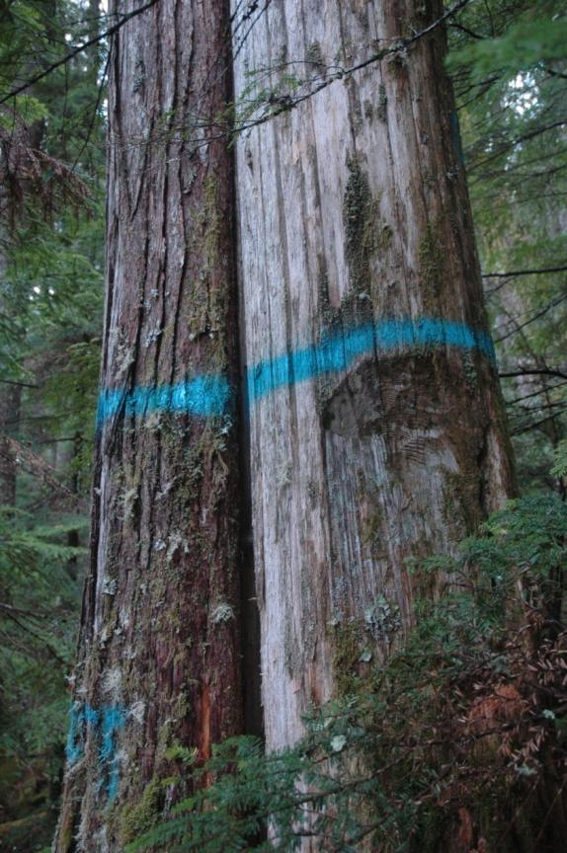
Plank Tree

Slide 44
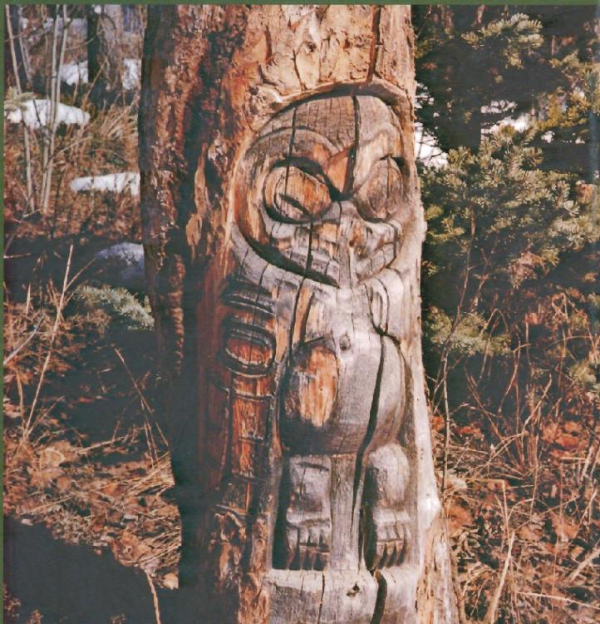
Arborglyph
Tlingit tree carving from Fredrick Lake, Yukon.
In Faces in the Forest by Michael Blackstock

Slide 45
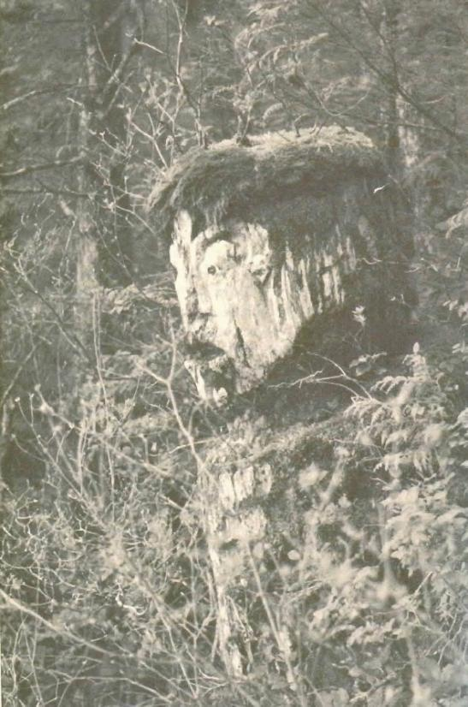
Arborglyph
Watchman pole near Kitimat.
In Faces in the Forest by Michael Blackstock

Slide 46
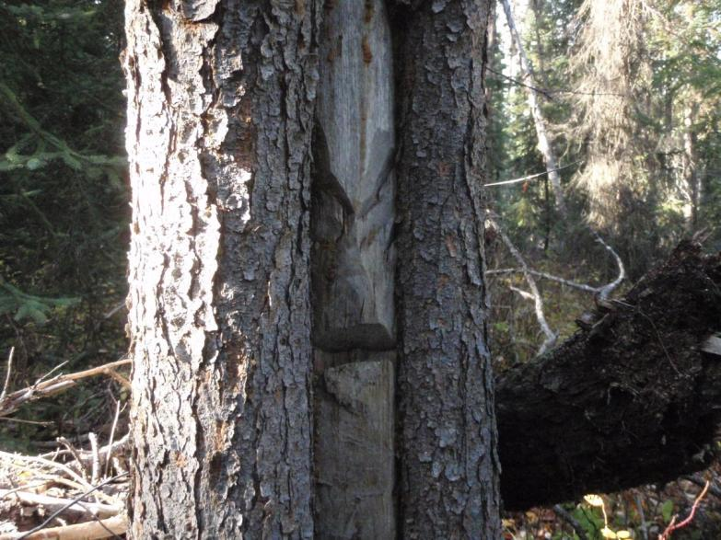
CMTs
Interior BC

Slide 47
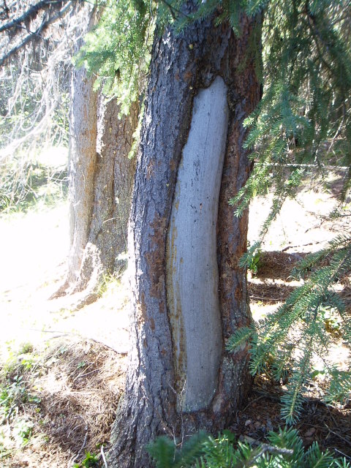
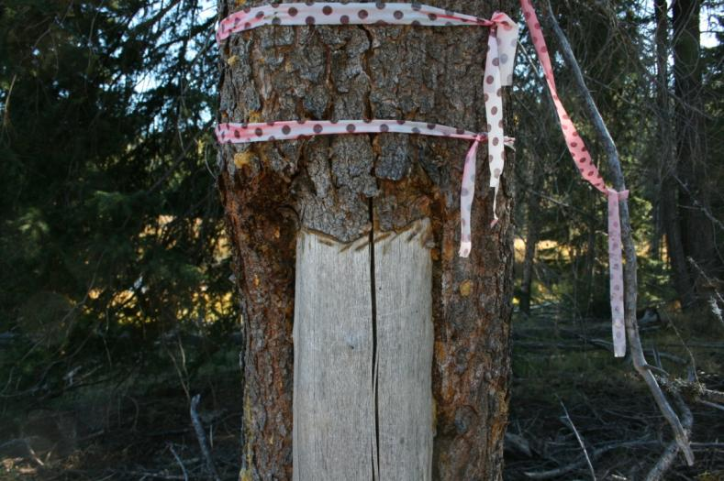
Cambium stripped

Slide 48
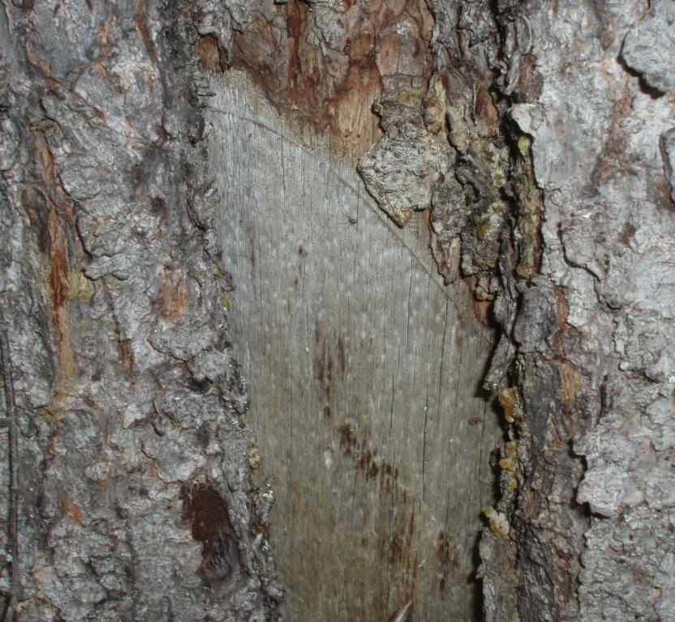
Cutmarks on a stripping by right-handed individual

Slide 49
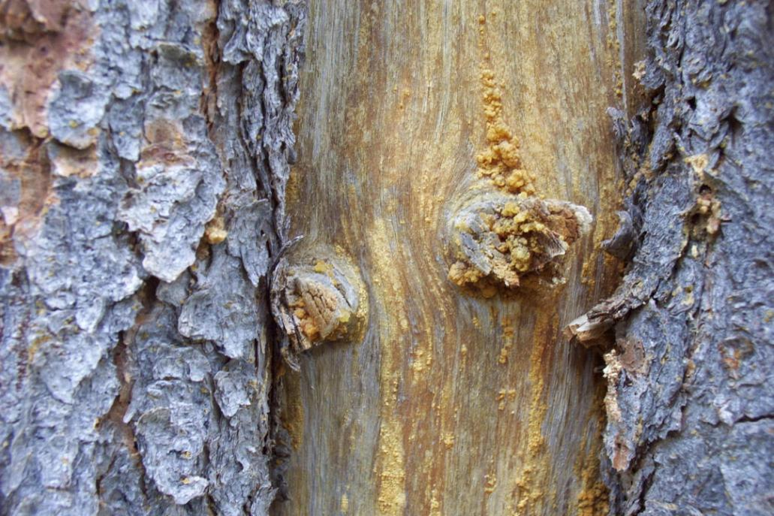
Cut branches

Slide 50
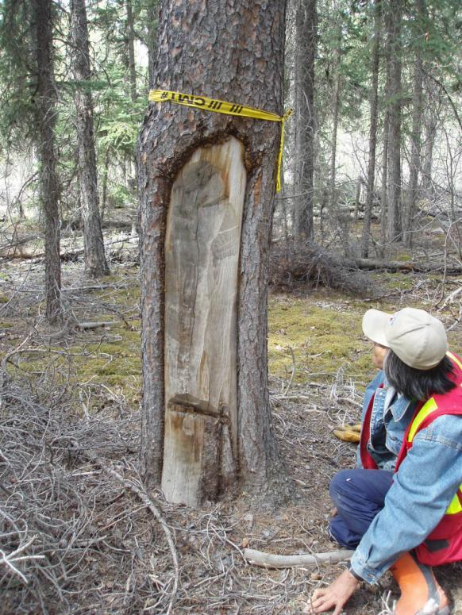
Chopping probably for kindling collection

Slide 51
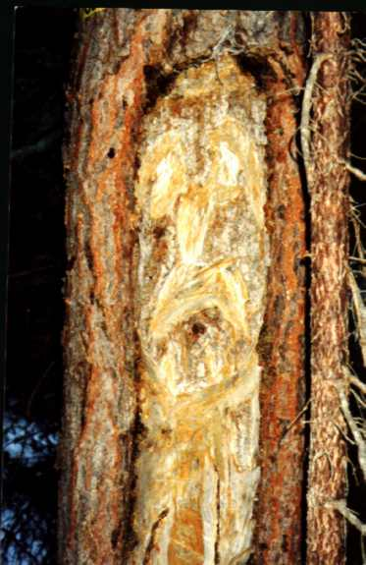
Arborglyph on lodgepole pine

Slide 52
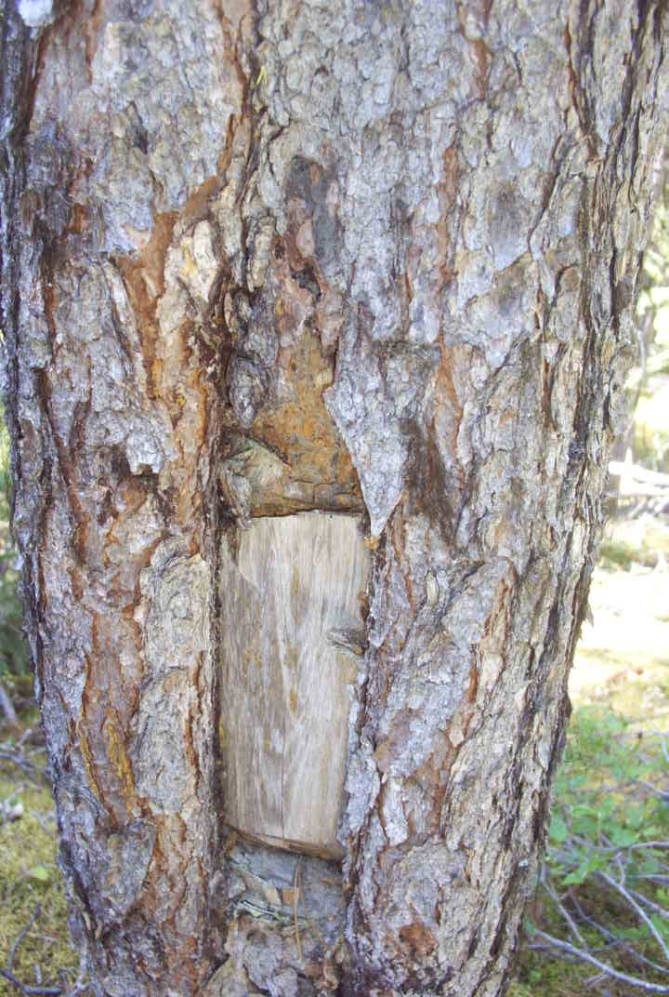
Trap Set/Trail Marker

Slide 53
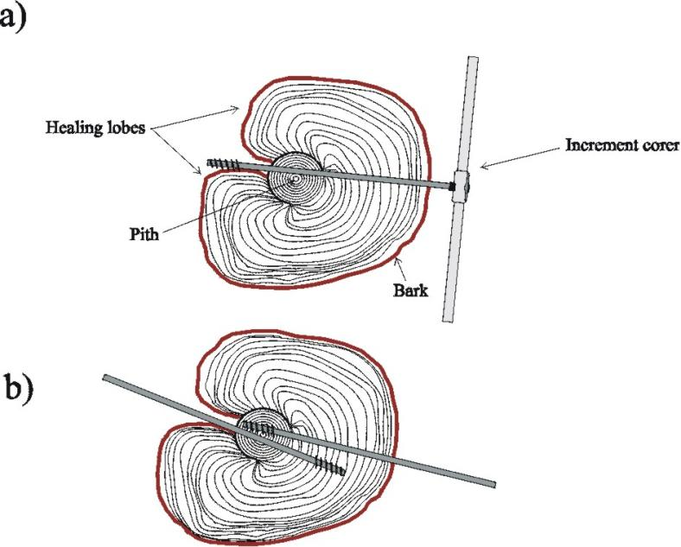
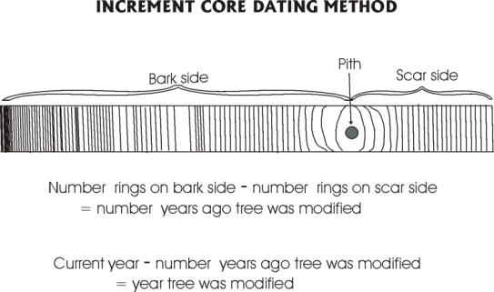
How CMTs are dated
Do not date CMTs during FREP monitoring

Slide 54
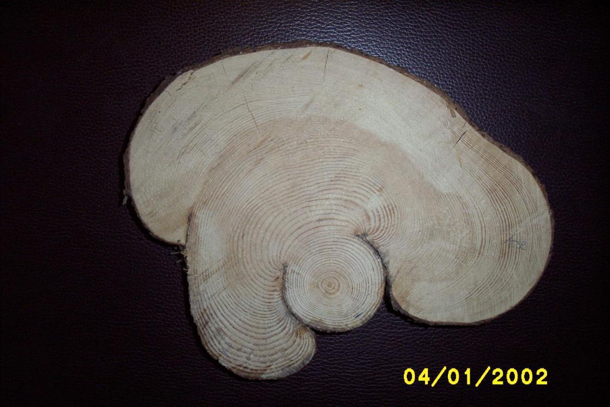
Stem round sample (SRS)

Slide 55
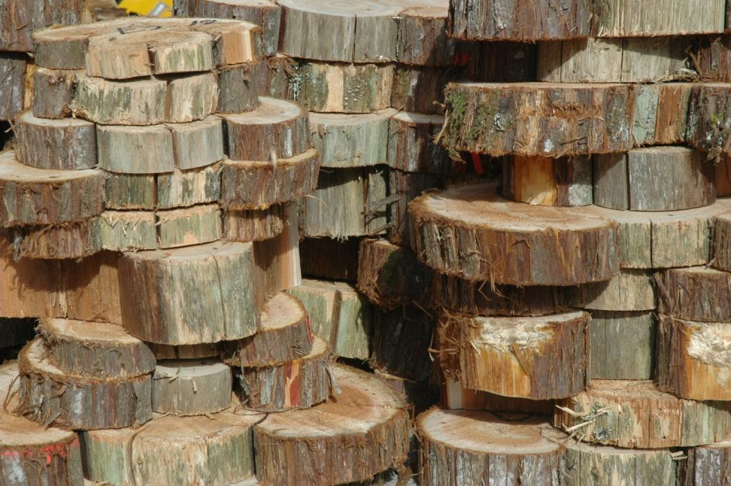
Stem round samples from protected pre-1846 CMTs, collected under Section 12 Site Alteration Permit

Slide 56
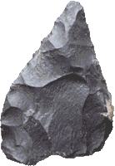
Archaeological sites
Cultural Material Sites

Slide 57
Cultural material
Cultural material is any object that has been made or modified by humans. It includes objects made from stone (chipped or ground), bone, metal tools, and ornaments.
Stone artifacts normally predate European contact.

Slide 58
Chipped stone artifacts

Slide 59
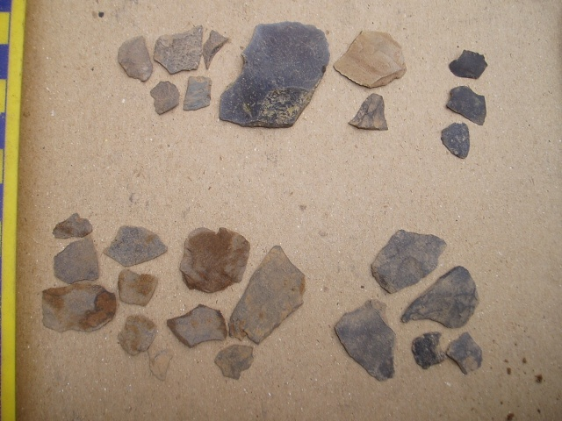
Lithic debitage (flakes)

Slide 60
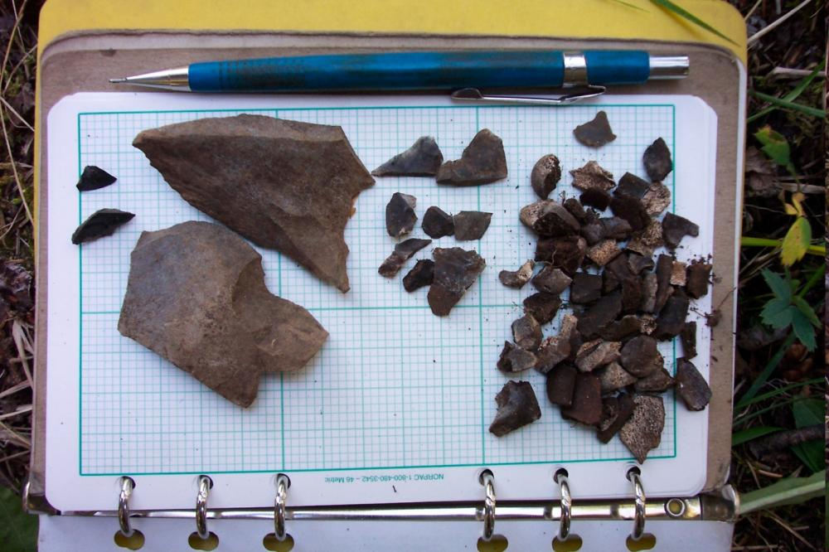
Flakes and calcine bone

Slide 61
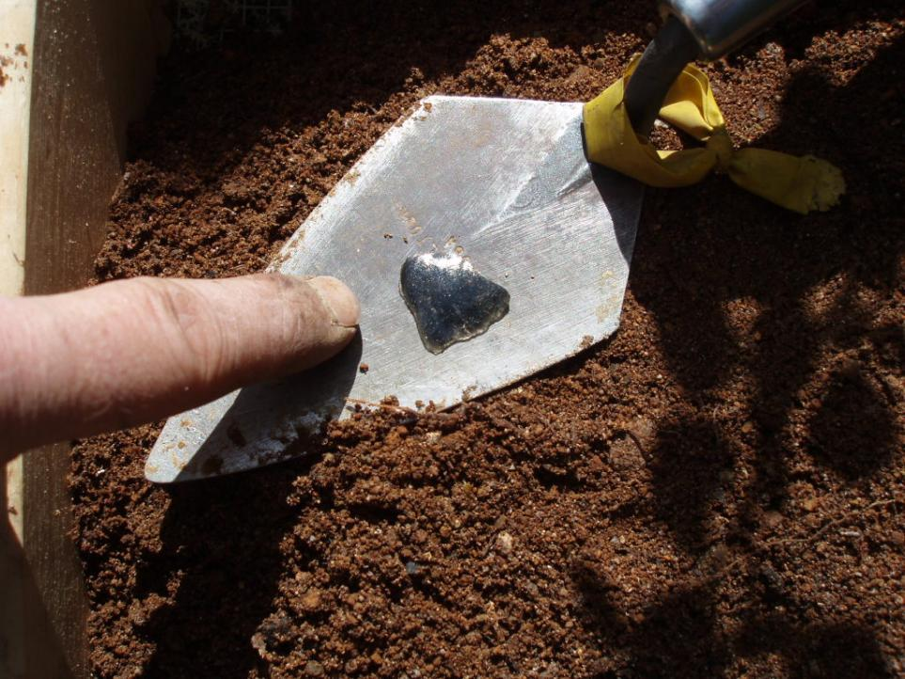
Obsidian flake

Slide 62
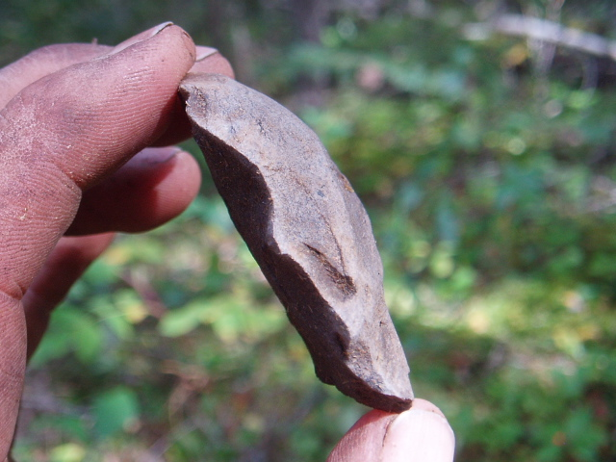
Expedient stone tool

Slide 63
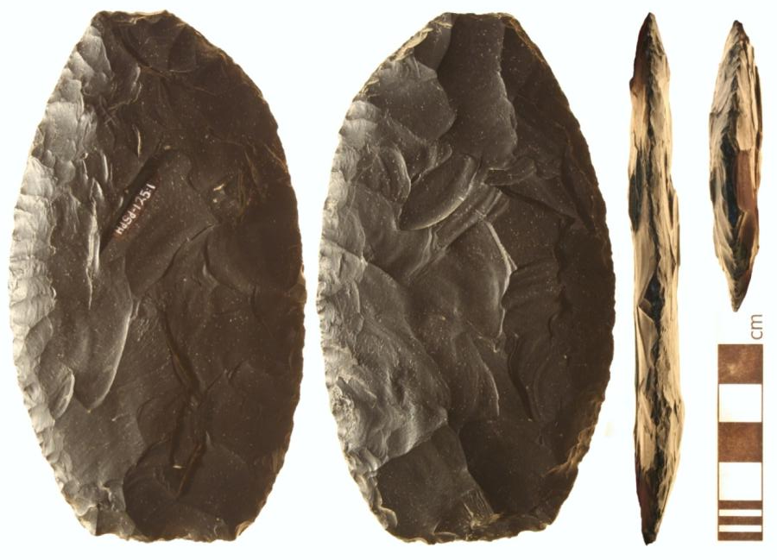
Basalt biface

Slide 64
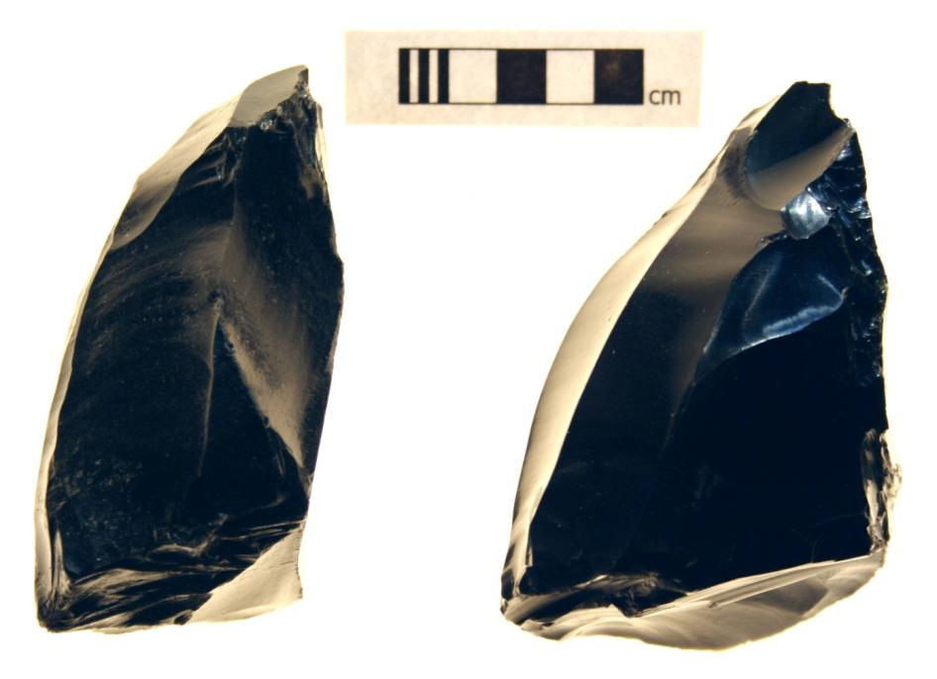
Obsidian core

Slide 65
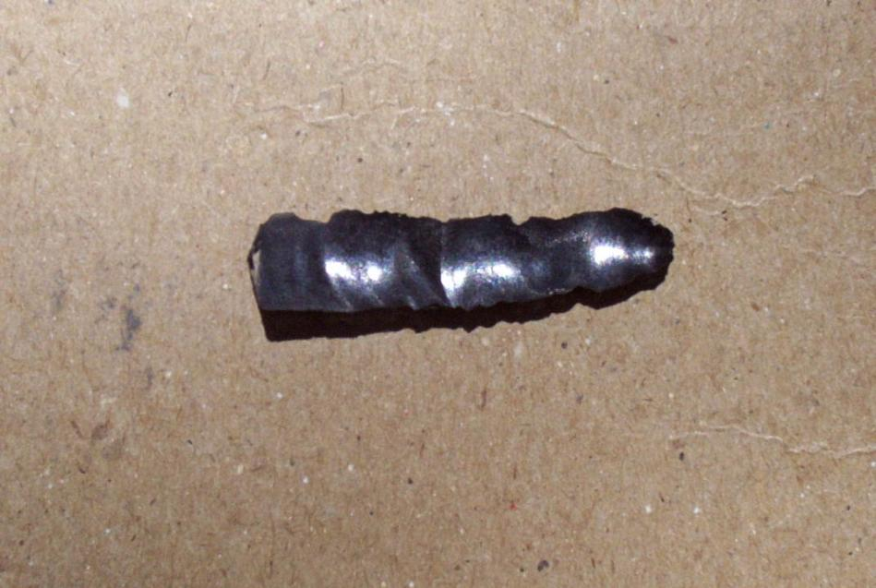
Obsidian microblade

Slide 66
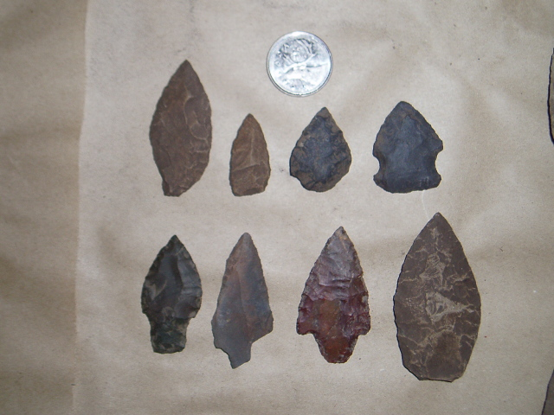
Projectile points

Slide 67
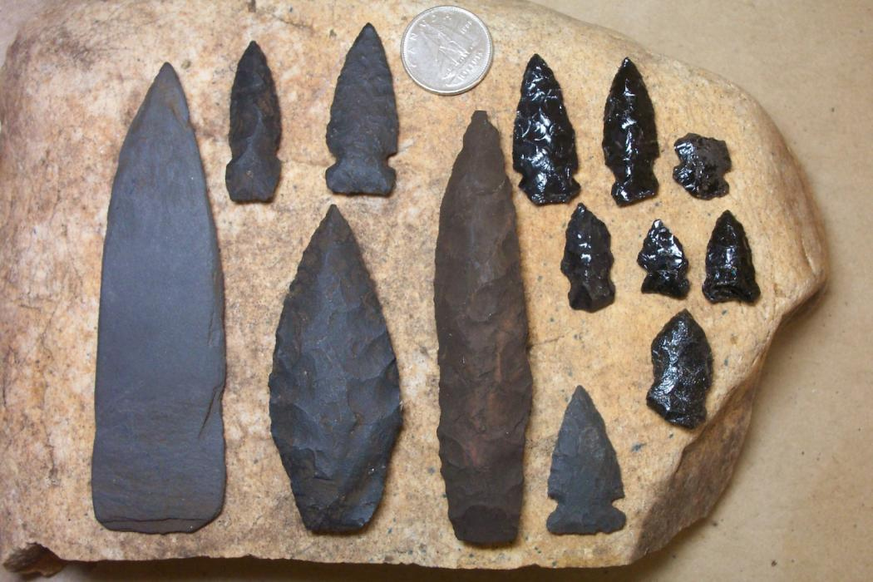
Large & small projectile points

Slide 68
Ground stone & pebble tool artifacts

Slide 69
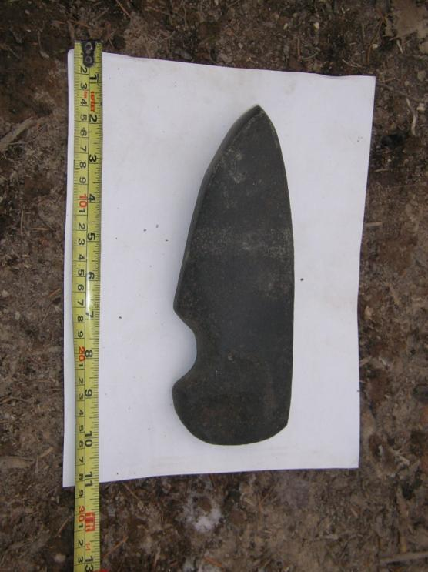
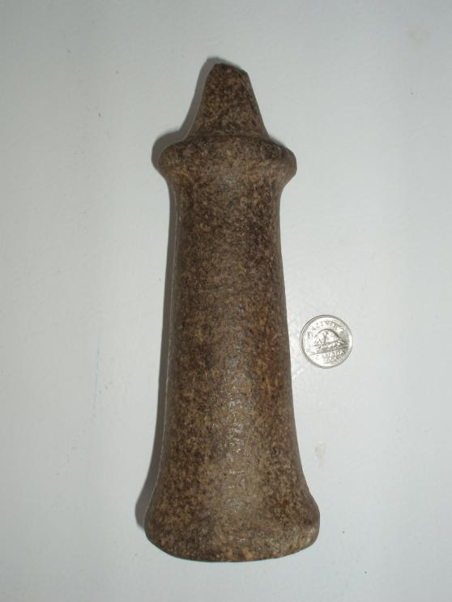
Adze and mortar from Terrace

Slide 70
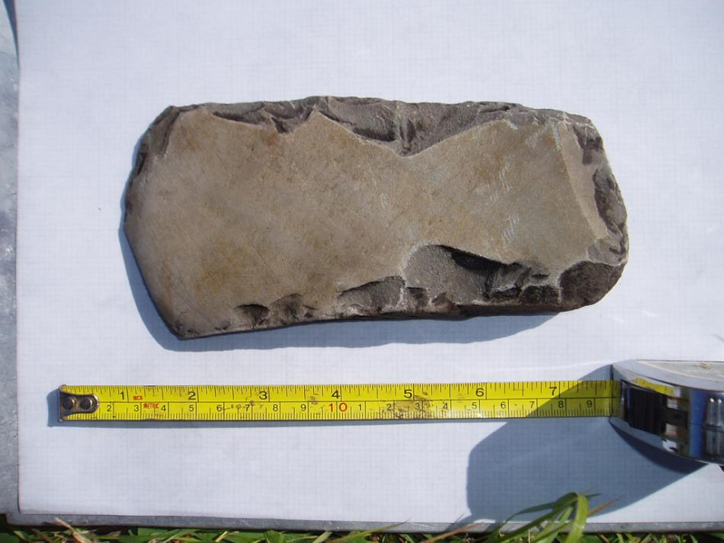
Wedge from Nautley Bridge

Slide 71

Pebble tools

Slide 72
Bone artifacts

Slide 73

Bone Artifacts

Slide 74

Bone ornament surface find in cutblock

Slide 75
Other artifacts

Slide 76


Ceramics (historic) and bone comb (pre-contact)

Slide 77


Interesting Artifacts

Slide 78

Trade beads & metal artifacts

Slide 79

Shell midden

Slide 80

Shell midden

Slide 81
Archaeological Contexts & Recovery Methods

Slide 82

Surface Inspection

Slide 83


Surface finds

Slide 84

Excavation trench

Slide 85

The basic geological principal of stratification applies to archaeological sites

Slide 86
Cultural Depressions
Cache pits, house pits & roasting pits

Slide 87

Structure of a cache pit

Slide 88
Physical characteristics of cache pits that are visible today include:
Relatively uniform appearance (round, oval or rectangular)
A berm or rim may be present around the outer edge (not just one side)
A rounded or bowled bottom as opposed to a flat one
Lots of moss growth in the pit which indicates it was not recently formed
Location – high, well drained area
Soil – relatively easy to dig

Slide 89

Cache pit south of Vanderhoof

Slide 90

Cache Pits at Tatin Lake

Slide 91

Cache Pit at Chinlac Village Post-wildfire

Slide 92

Deep circular cache pit

Slide 93

Large cache pit

Slide 94

Cache pit excavated in PG (300 yrs old)

Slide 95

Roasting pit at Tatelkuz Lake @ 1700 BP (300 AD)

Slide 96

Structure of a House Pit

Slide 97

House pit on the Cheslatta River

Slide 98

House Pit at Hallet Lake

Slide 99

House Pit near Tommy Lakes

Slide 100

House pit with a large rim

Slide 101

Lodge depressions at Chinlac Village

Slide 102

Aerial view of cultural depressions at Keatley Creek

Slide 103
If I find a CD can we just avoid it?
With the correct training personnel can identify CD features in the field BUT
only an qualified archaeologist can correctly determine the extent and significance of the site and how best to manage for it.
There is more than meets the eye to many CD sites.

Slide 104

Cultural depressions avoided but not shovel tested

Slide 105

Same site with boundaries expanded after shovel testing

Slide 106
Agents of non-cultural depressions that may be mistaken for cache pits or house pits
Tree throw
shape
berm present
Moose hollow
depth
vegetation cover
Den cave-in
on sloping bank
mounds
location
hollow
shape
depth
Water flow
floodplains
wet locations

Slide 107
Cultural Heritage Trails

Slide 108

Omineca Trail

Slide 109

Cheslatta Trail (protected trail)

Slide 110


Trails identified in logging blocks

Slide 111

Historic Telegraph Trail protected & non-protected sections

Slide 112
Other Archaeological Sites

Slide 113


Rock Art
Pictographs
(painted or drawn)

Slide 114

Pictograph location

Slide 115

Pictographs

Slide 116

Burial

Slide 117

Hearth

Slide 118

Fire-cracked rock

Slide 119
TUS/Historic Sites
Unprotected CHR sites with cultural remains

Slide 120

Historic Site
Stone oven associated with railway construction near Horsefly

Slide 121

Tie cutting cabin

Slide 122

Historic ink bottle from Prince George

Slide 123

Sharpened stick cache (fish weir poles?)

Slide 124

Cottonwood canoe

Slide 125
CHR Site
Other CHR sites of cultural significance

Slide 126

Traditional, ceremonial & spiritual use sites

Slide 127

Traditional Fishing – Moricetown Canyon

Slide 128

Sacred Mountain

Slide 129

Caves

Slide 130

Rock shelters

Slide 131
Ecological features of cultural significance

Slide 132

Mineral source

Slide 133

Cultural Plants

Slide 134


Birch Bark Collection

Slide 135

Labrador tea, culturally managed and harvested

Slide 136

Break Time

Slide 137
CHR Monitoring
Office Planning and documentation

Slide 138

Notes:
Office prep – three of the four steps
This is Figure 4 in the protocol – page 26

Slide 139

Step 1 – Know Your CHR Information
Notes:
A word about a “complete inventory”: This is the Perfect World
Districts (hopefully) have some kind of CHR information inventory in place and (hopefully) it is updated regularly – this is the perfect world
- E.g. “inventory” could include Archaeological Potential/Predictive Model, Traditional Use Studies, CMT survey database, AIAs, etc
At very least, consultation coordinator will know what information is available for the district and where to find it
Information will vary in type and availability – every district is different
**Focus for CHR monitoring will be on the information that the licensee knows about and is available at the time the block is planned and management strategies for CHR are developed

Slide 140
Sources of CHR information
Archaeological potential/predictive modeling
Archaeological overview assessment (AOA)
Preliminary field reconnaissance (PFR)
Archaeological impact assessment (AIA)
    HCA Permit required
    HCA S. 12 Site Alteration Permit
Archaeological Inventory Study (AIS)
    HCA Permit required
Notes:
There are many, many sources of CHR information
Archaeological Potential Mapping/ Predictive model – District models – cover large areas
Archaeological Overview Assessment
** GIS mapping exercises using existing knowledge to map areas with potential archaeological values – larger scale, district - le
Preliminary Field Reconnaissance – A field AOA used to help design and implement more intensive surveys (AIA) – site specific
AIA – used to assess potential conflicts between proposed development and archaeological resources – site specific
Arch Inventory Study – identification and recording of arch resources within an area – not all that common

Slide 141
Sources of CHR information
CMT Survey
Pre-harvest CHR survey
Traditional use Study
Consultation/Referral Records
Site Plan/Silviculture Prescription
Personal Communication
Notes:
CMT surveys – proponents
Pre-harvest CHR survey – individual cutblock and often First Nation driven
Traditional Use Study – online map tool and documentation (if permission is given by FN) – compilation of specific site information and use, gathered through interviews and
Consultation and information sharing – government and licensee – compilation of known information
**Site Plan – operational level management of CHR – compilation of known information
Personal communication with FNs

Slide 142
Other databases and websites
Direct contact with First Nations and Licensees
Remote Access to Archaeological Data(RAAD)
First Nations Consultative Areas Database (CAD)
iMap (consultative areas and TUS mapping)
Aboriginal Engagement Corporate Information Site (AECIS)
Provincial Archaeological Report Library
District data bases – e.g. DVA_ARP, LARP
Notes:
In addition to First Nations providing “known” information for our monitoring, FNs might provide information that was not known at the time of the plan development and approval. We cannot fairly assess a licensee on the management of CHR features if new information is brought forward that was not shared with the licensee or government prior to approval to harvest a block.
If FNs provide new information after development has occurred, this is still a positive step as it can inform other potential development in the future. It is also an opportunity to inform everyone (licensees, gov’t and FNs) that there is always room for better communication, reiterating that concerns should be raised up front so that consideration and/or accommodation can be made to address those concerns. FN’s often do not share information when requested, generally for the simple fact that they may not have the capacity (i.e. staff, time, GIS resources) to deal with an endless stream of letters from forestry, range, mines, transportation, etc asking for their input on development in their traditional territory.
More databases of information
Not an exhaustive list – see protocol pages 21 to 24

Slide 143
Key information for CHR monitoring
Consultation and/or Information Sharing Records
Site Plan/Silviculture Prescription and any support documents
  AIA
  HCA S. 12 Site Alteration Permit
RAAD
Local/ District data base (if available)
District policies – e.g. trail management, CMT management
Notes:
Best strategy for gathering information during the office preparation phase of CHR monitoring is to work from the site plan.
Management strategies will be based on what is known and available to the licensees
** also important to ask the licensee if any sites/features were “managed” by avoidance or exclusion, but is silent on that strategy in the site plan - ultimately trying to ascertain whether there was a management decision made so that site/feature management is assessed correctly.
1. Consultation and Info sharing –information brought forward by First Nations and any management decisions or accommodations made to address the information or concerns
2. SP and supporting documents – should incorporate any information and recommendations from AIA, and it may include site alteration permit
3. RAAD – likely incorporated in AIA
4. Local/ District data base – information typically would be brought forward during consultation
5. District policies on trail management, CMT management

Slide 144

Step 2 – Select field Sites
Notes:
Demonstrate FREP IMS
https://apps18.for.gov.bc.ca/frep

Slide 145
Key Parameters
Minimum 6 blocks per district
  At least 50% randomly selected
    FREP random list
  Up to 50% targeted
    Select in collaboration with FNs and licensees where possible
    Special CHR management, specific concerns..
    Consider equity among FNs, administrative boundaries, etc.
Notes:
Go to FREP IMS HERE – demonstrate random list
https://apps18.for.gov.bc.ca/frep

Slide 146
Key Parameters
Focus on blocks with identified CHRs
  AIA
  RAAD
Do not sample blocks if:
  no CHR sites or features exist
  A First Nation has expressed an objection
  safety issues exist
  CHR is outside influence of management
Notes:
RAAD – may have a block that excludes a site/feature and is silent in site plan. Need to ascertain through conversation with licensees as to whether a management decision was made with respect to that site/feature
Outside influence of management - subjective

Slide 147

Step 3 – Office Prep

Slide 148

Example

Slide 149


Form A
Notes:
Form A – 1 per cutblock (fill out sections 1-3 in office)

Slide 150

Form A Side 1 – Opening Information
Collect site plan and/or site map, access information, orthophotos/ aerial photos (if available)
Fill in the opening ID section
Notes:
You’ve gone to IMS, found a block with a site/features – now you gather all the supporting information you need to fill out the cards in the office and to do the field assessment

Slide 151


Form A Side 1 – Section 2 - Summary of Known CHR Sites/ Features
  List ALL sites or features within/ adjacent to the cutblock
  Provides information on data sources
    Each will have a unique Feature ID
    Choose appropriate description and information source codes
    Associated features
Notes:
List all sites and features, whether you end up assessing in the field or not
This list is based on the information you have gathered – potential sites/features. You may add to it after you have been in the field, in case you find something not mentioned in the documentation you have gathered.

Slide 152
Individual versus Composite features
Individual feature
  A single feature type
  E.g., Single CMT, stand of CMTs, cache pit(s), bear den
Composite feature
  Two or more different, closely associated features/sites
  Generally managed using the same strategy
  E.g., a cultural trail with adjacent cache pits and CMTs that are managed through site avoidance
Notes:
Associated features – features are quite often associated with each other – e.g. Trail, CMTs, cache pits all may make up a site.
Please fill in the card to identify which features are associated with others, if this is the case.
Can judge before you go out, and re-assess in the field whether assigning a feature or site as an individual or composite feature is logical or not – i.e. Different management strategies, find unidentified features associated with a single feature
Use your judgement, logic

Slide 153


Form A Side 1 – Section 2 - Example
Notes:
List all known sites/ feature associated with the opening, whether visited in the field or not
Each is summarized individually – unique ID
In this example, I went back and added information from field observations

Slide 154



Form A Side 1 – Section 2 – Example
Features 1 - 2
Notes:
FkRv-33 and traditional use CMT = Features 1 and 2 – originally was going to assess as composite, but once in the field, I assessed as individual features. This was mainly because the CMTs were within the harvest area and the cultural depression/cache pit was excluded and on the edge just outside the block.
FkRv- 34 - Features 3 and 4– treated as a composite feature for assessment

Slide 155


Form A Side 1 – Section 2 – Example
Features 1 - 4
Notes:
FkRv-33 and traditional use CMT = Features 1 and 2 – treated as individual features for assessment
FkRv- 34 - Features 3 and 4– treated as a composite feature for assessment

Slide 156


Form A Side 1 – Section 2 – Example
Features 5, 6 and 7
Notes:
Features 5, 6 and 7 – treated as a composite feature for assessment

Slide 157

Form A Side 2 – Contact
  Record of contact and site attendance with FNs and proponents
Notes:
Rest of Form A is the block summary filled out after the field work is complete.

Slide 158

Form B
Fill a Form B out for each individual feature and/or each composite feature
Notes:
Form B – 1 per individual feature and/or per composite features

Slide 159

Form B Side 1 – Sections 1 to 3
Individual Feature
Opening ID
Feature ID(s) from Form A
Individual or Composite
Composite ID #
Check off the feature/site type (s)
Size if applicable
UTM Coordinates (optional)
Location wrt the block
Notes:
Location – at discretion of field assessor – confidentiality, sensitivity
This example is for Feature 2 – FkRv-33 CMTs – assessed as ‘individual features’
Note that a stand of CMTS (homogenous) is considered a ‘single feature’

Slide 160

Form B Side 1 – Sections 1 to 3
Composite Feature
Notes:
For FkRv -32 : 65 hectare site
Features 5, 6 and 7 are assessed as a composite – all excluded within a stand of trees outside the block within one archaeological site (as per AIA)

Slide 161

Form B Side 1 – Section 4
  Management recommendation(s) by First Nations
  Recommendations in AIA or site alteration permit (if applicable)
  Identifies the SP management strategy
Notes:
Before going into the field, review any:
Management recommendations by First Nations, or established protocols for site management (e.g. cultural trail management protocol)
AIA recommendations or site alteration permits
Site plan for cutblocks and any actions to conserve or protect CHRs
FSP results or strategies
Info sharing/ consultation records

Slide 162
CHR Monitoring
Field card documentation

Slide 163

Salmon Bay Over view Map

Slide 164

Salmon Bay Reccie Map

Slide 165


Point of Commencement (POC)

Slide 166


SLBD and Riparian Values

Slide 167



Shortest Distance between 2 points?

Slide 168


Locating the Site/Feature

Slide 169

Form A Side 1 (office)

Slide 170


In Perspective

Slide 171



Site Reserve and Feature

Slide 172

Form B Side 1
Site/Feature description

Slide 173

Form B Side 1
Site/Feature description (continued)

Slide 174

Site Reserve and Feature

Slide 175

Form B Side 2
Site/Management Effectiveness

Slide 176

Site Reserve and Feature

Slide 177

Form B Side 2
Site/Management Effectiveness (cont.)

Slide 178



Other Considerations

Slide 179

Form A Side 2
Block summary

Slide 180

Form A Side 2
Block summary (cont.)

Slide 181

Form C Side 1
Additional comments

Slide 182


Point of Termination

